Slide 1
Financial Maths
Rule up 3 column notes!
Topic: Percentage Recap
EQ: How do I work out the % of an amount?
Mrs Stretch
Year 8

Slide 2
24
7
30
Percentage Recap
Date
EQ – How do I work out the % of an amount?
Question
Examples
Steps
How do I calculate the percentage of a number?
30% of 50
1. Express the percentage as a fraction.
(% is always out of 100)
2. Change the ‘of’ to a multiplication sign.

Slide 3
24
7
30
Percentage Recap
Date
EQ – How do I work out the % of an amount?
Examples
Steps
1. Express the percentage as a fraction.
(% is always out of 100)
2. Change the ‘of’ to a multiplication sign.

Slide 4


Slide 5
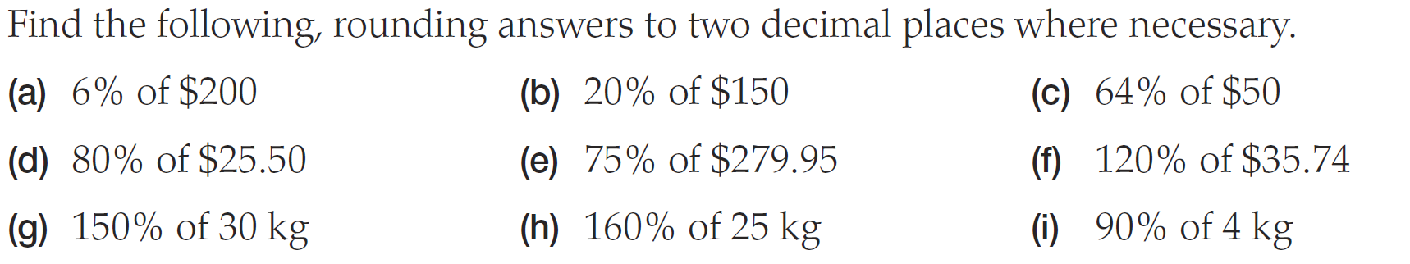
Practice

Slide 6
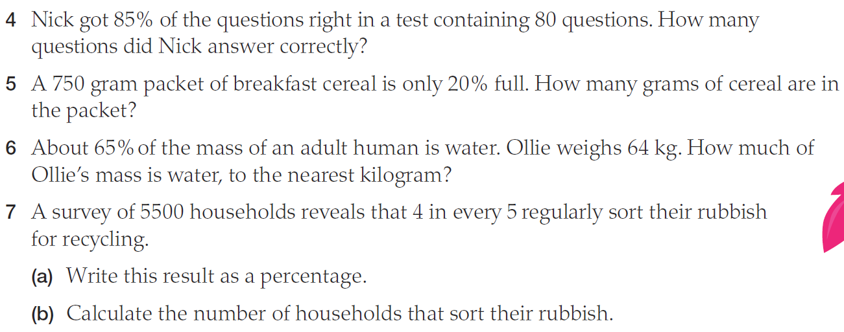
Worded Questions

Slide 7
Percentage Bingo
Aim: Full House
Grid: 9 Grid
Play: Calculate answer & cross it off

Slide 8
Use any of these numbers in your grid (NO REPEATS)
24 12 25 63
49 48 15 36
21 54 30 16
9 10 55 33

Slide 9
Question
5% of 1080

Slide 10
Question
30% of 40

Slide 11
Question
5% of 180

Slide 12
Question
90% of 40

Slide 13
Question
20% of 120

Slide 14
Question
12.5% of 200

Slide 15
Question
50% of 60

Slide 16
Question
110% of 50

Slide 17
Question
30% of 210

Slide 18
Question
150% of 10

Slide 19
Question
40% of 120

Slide 20
Question
70% of 70

Slide 21
Question
125% of 8

Slide 22
Question
10% of 160

Slide 23
Question
11% of 300

Slide 24
Question
30% of 70

